Slide 1
Fold Mountains
Chapter
4
Learning outcomes: 1.1

Slide 2
At the end of this chapter, you will be able to:
4.1 Explain how fold mountains are formed.
4.2 Describe the distribution of fold mountains.
4.3 Describe the economic and social impacts of fold mountains.

Slide 3
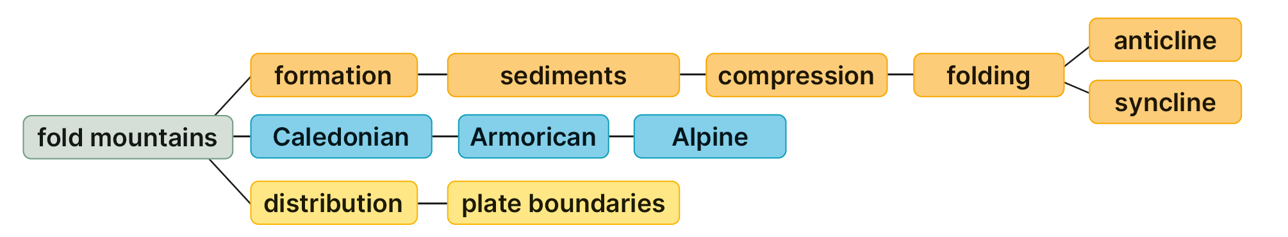
Keyword connections

Slide 4
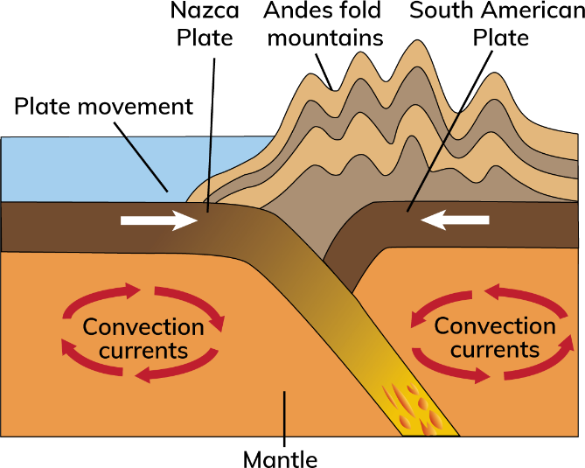
How fold mountains are formed.

Slide 5
4.1 Explain how fold mountains are formed.
Fold mountains are formed when two plates collide.
The heavier plate (oceanic) sinks into the mantle.
The lighter plate (continental) crumples and the layers of rock fold upwards.
Long, narrow ridges called anticlines are formed. These are the mountains. The valleys in between ridges are called synclines.
Example: The Andes mountains in South America were formed when the Nazca Plate collided with the South American Plate.

Slide 6
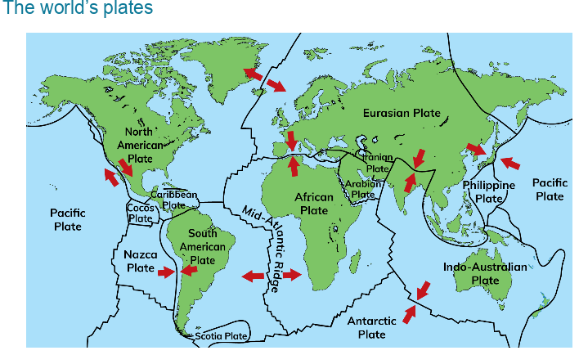
Example: The Andes mountains in South America were formed when the Nazca Plate collided with the South American Plate.

Slide 7
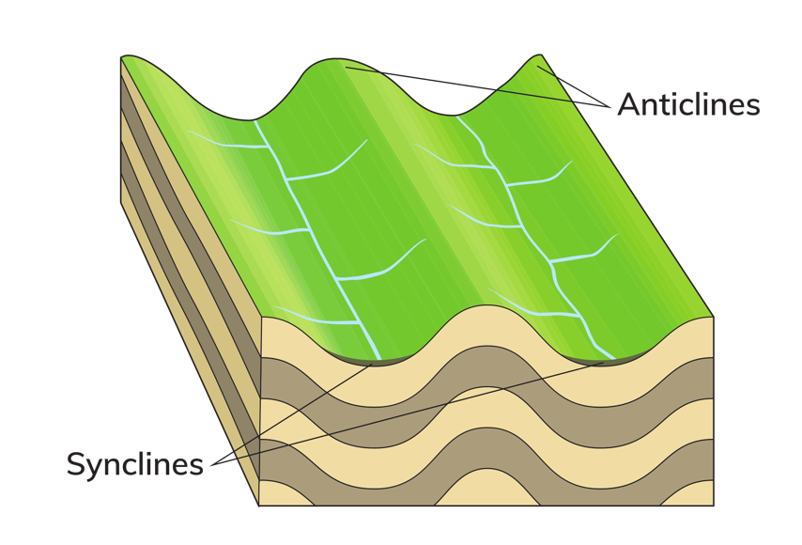
4.1 Explain how fold mountains are formed. (continued)
A syncline is the name given to a downward fold. Synclines are the valleys lying between fold mountains.
An anticline is a long, narrow ridge formed by folding at a colliding plate boundary.
Fun Fact: Folding is the reason why fossils are sometimes found high up in mountains.

Slide 8
4.1 Explain how fold mountains are formed.
Go to Section 4.1 on page 13 of your Skills Book.

Slide 9
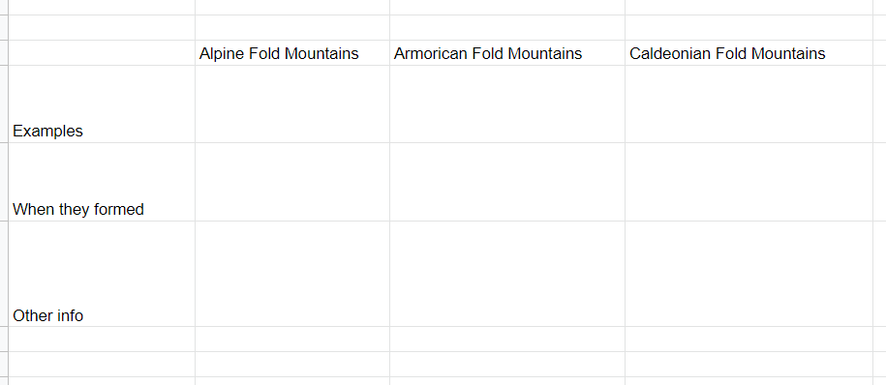
4.2 Describe the distribution of fold mountains.
There are three main fold mountain periods on Earth: Caledonian, Armorican and Alpine.

Slide 10
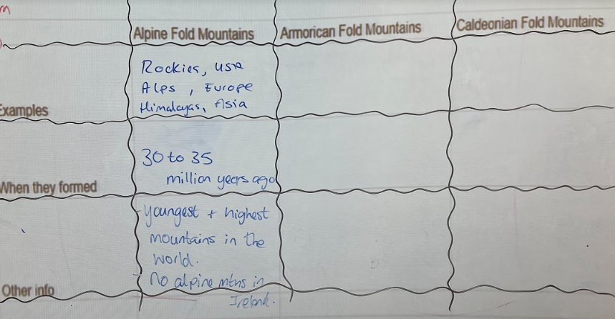

Slide 11
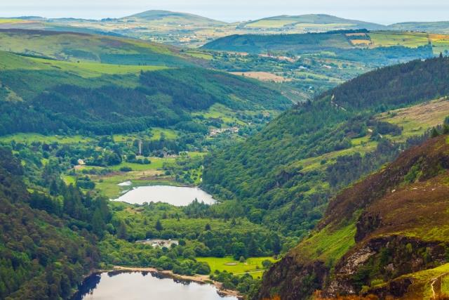
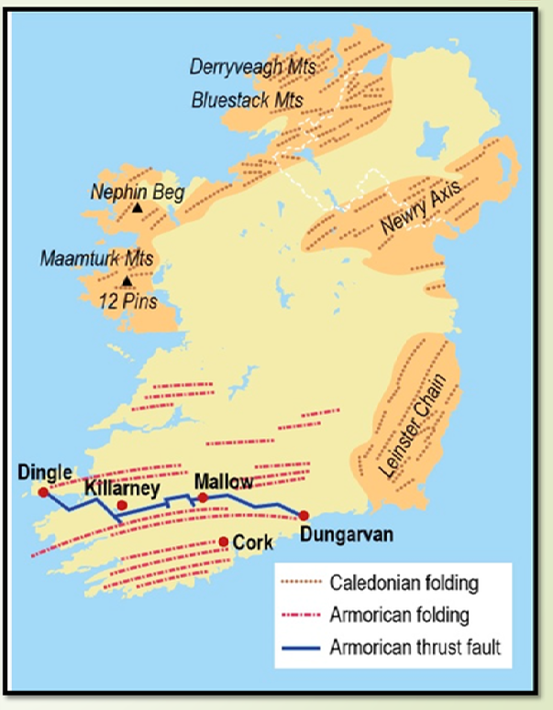
4.2 Describe the distribution of fold mountains.
1. The Caledonian fold mountains
These mountains are named after the Latin name for Scotland – Caledonia.
They were formed 400 million years ago.
These mountains have been worn away (weathered and eroded) over time and usually have rounded peaks.
Examples include mountains in Donegal, Wicklow and Scotland.

Slide 12
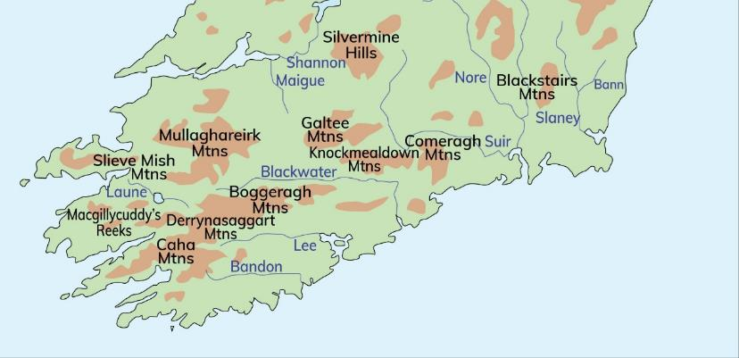
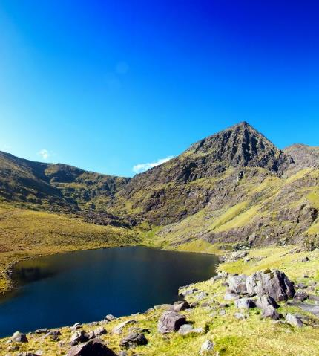
2. The Armorican fold mountains
The African Plate collided with the Eurasian Plate 250 million years ago.
Ireland was at the northern edge of this mountain-building period.
This produced the fold mountains of Munster, including MacGillycuddy’s Reeks, the Galtees and the Knockmealdowns.
This part of Ireland is sometimes called the Ridge and Valley Province. These were once as high as the Alps but have worn down over time.
Fun Fact : Whats the highest mountain in Ireland?

Slide 13
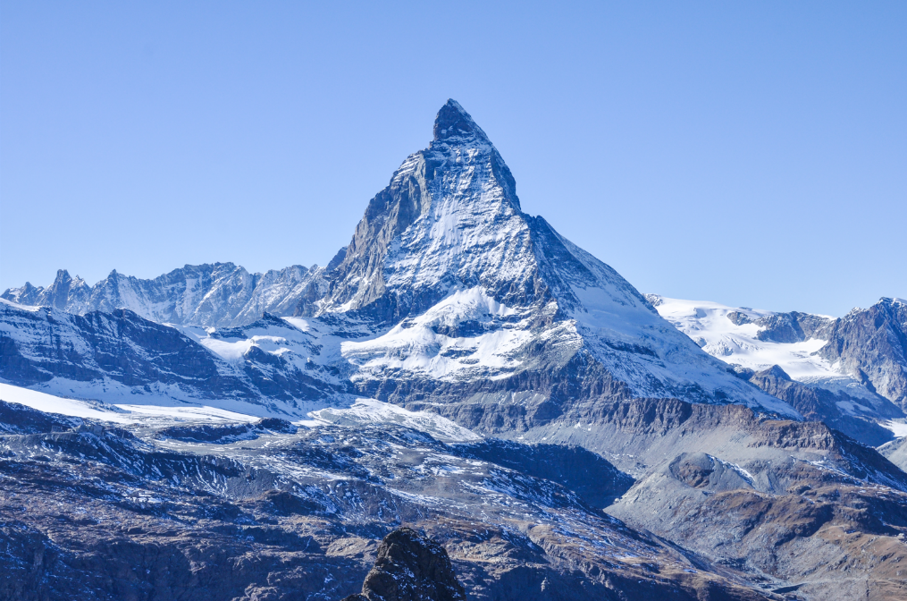
4.2 Describe the distribution of fold mountains.
3. The Alpine fold mountains
These were formed 30 to 35 million years ago.
They are the youngest and highest mountains in the world.
They include the Rockies in North America, the Alps in Europe and the Himalayas in Asia.

Slide 14
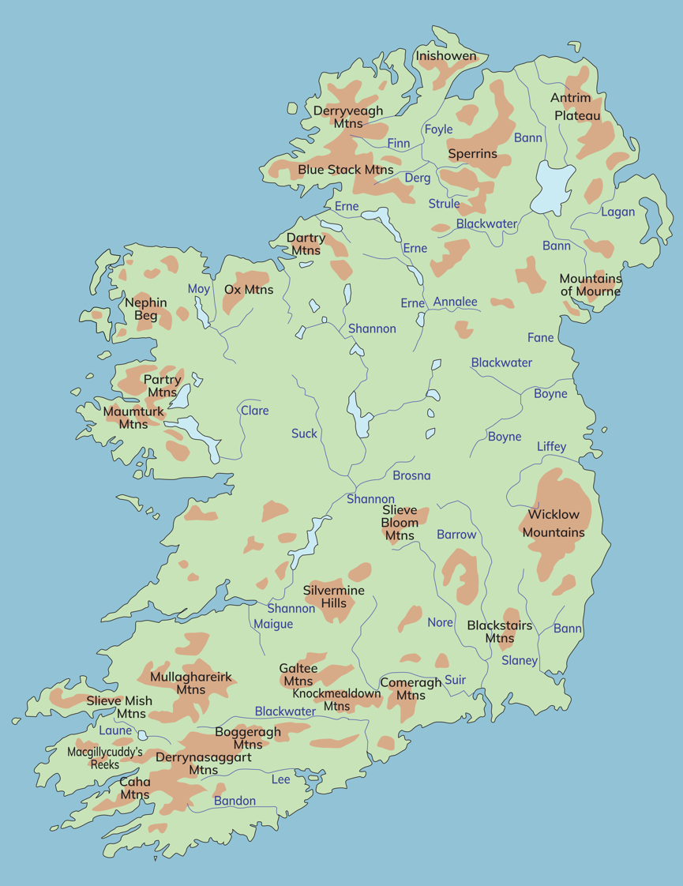
4.2 Describe the distribution of fold mountains.

Slide 15

4.1 and 4.2
1. Why are fold mountains so called?
2. Name and give an example of two different fold mountain periods in Ireland.
3. Mountain and valley: which one is a syncline and which is an anticline?
4. When were the Alps and the Himalayas formed?
5. What are the oldest mountains in Ireland?

Slide 16
4.1 and 4.2
Higher-order questions 1
1. Can fold mountains form when two oceanic plates collide? Explain your answer.
2. What mountains are closest to your school? To which mountain-building period do you think they belong?
3. Why do you think geographers study fold mountains? List as many reasons as you can think of.

Slide 17
4.2 Describe the distribution of fold mountains.
Go to Section 4.2 on page 14 of your Skills Book.

Slide 18
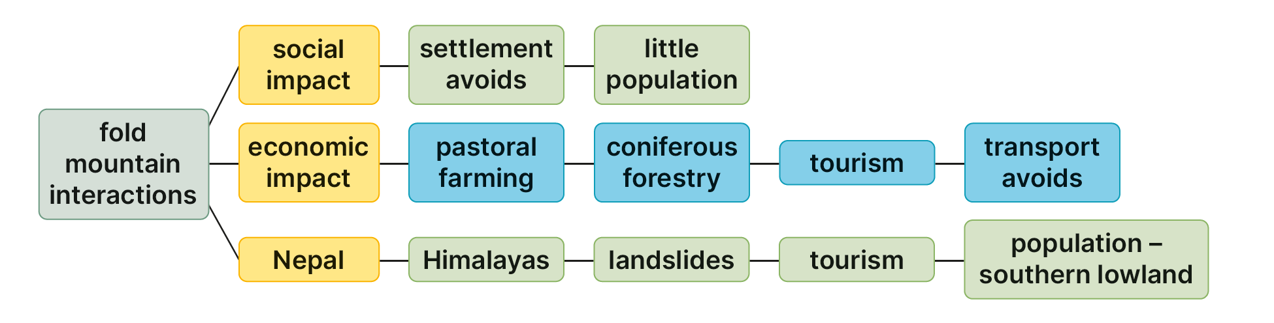
4.3 Describe the economic and social impacts of fold mountains.
Keyword connections

Slide 19
4.3 Describe the economic and social impacts of fold mountains.
Economic impacts – farming
Upland areas are only suitable for pastoral farming (e.g. grazing sheep).
Steep slopes = farmer may use upland for forestry.
Coillte – state forestry agency – has much of its forests in upland areas E.G.: Wicklow Mountains
The trees grown upland are always coniferous trees (evergreen). They survive colder temperatures.

Slide 20
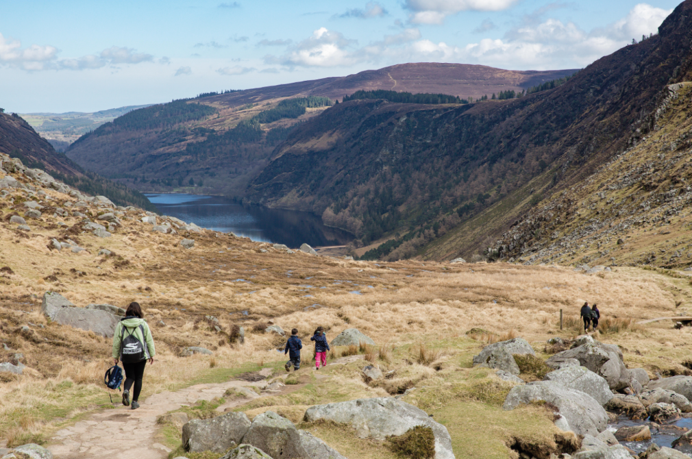
4.3 Describe the economic and social impacts of fold mountains.
Economic impact – tourism
Tourist attractions, e.g. picnic and viewpoint sites.
Hiking in top-5 tourist activities in Ireland.
Brings visitors into regions such as the Ridge and Valley Province in Munster.
Visitors spend money on local services such as hotels and restaurants
Creates jobs.

Slide 21
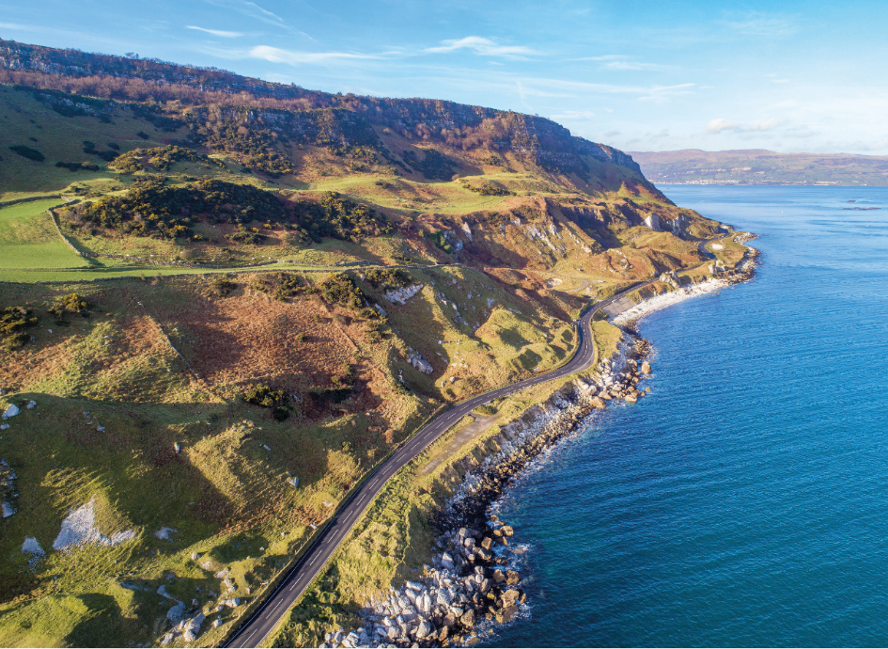
4.3 Describe the economic and social impacts of fold mountains.
Economic impacts – transport
It is more difficult to build in upland areas
It can be too expensive to drill tunnels through mountains for roads.
Major roads and railways often must go around mountains. E.G.Dingle peninsula in Co. Kerry.
Longer journeys add to the cost of transport.
Makes mountainous areas less attractive for the location of industry.

Slide 22
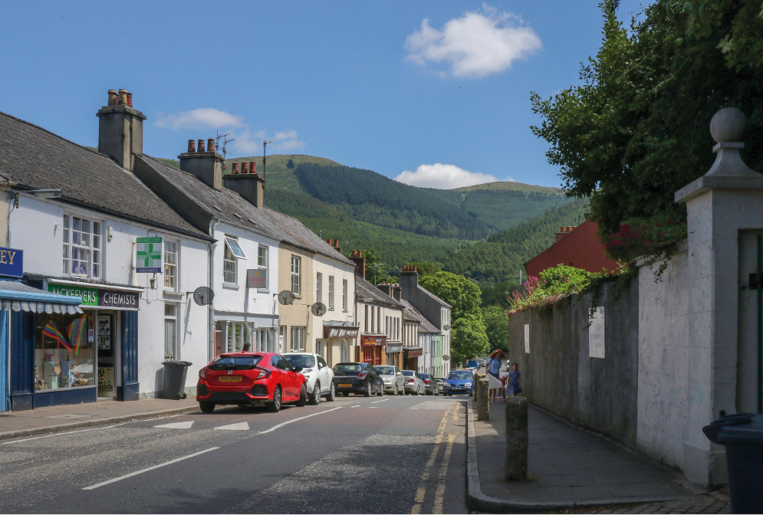
4.3 Describe the economic and social impacts of fold mountains.
Social impact – settlement and population
Few people want to live in upland areas
Windier, wetter and colder
Upland areas are difficult to farm
Settlement tends to occur in lowland areas.
This means mountains have few services, such as schools and shops
There are few people, so there are few services; there are few services, so few people want to live there (vicious cycle)

Slide 23

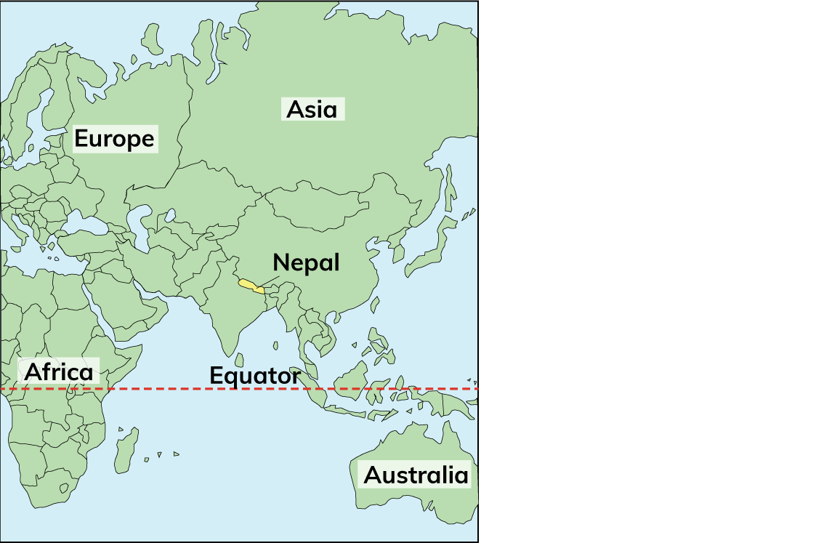
4.3 Describe the economic and social impacts of fold mountains.
The impact of fold mountains on Nepal

Slide 24
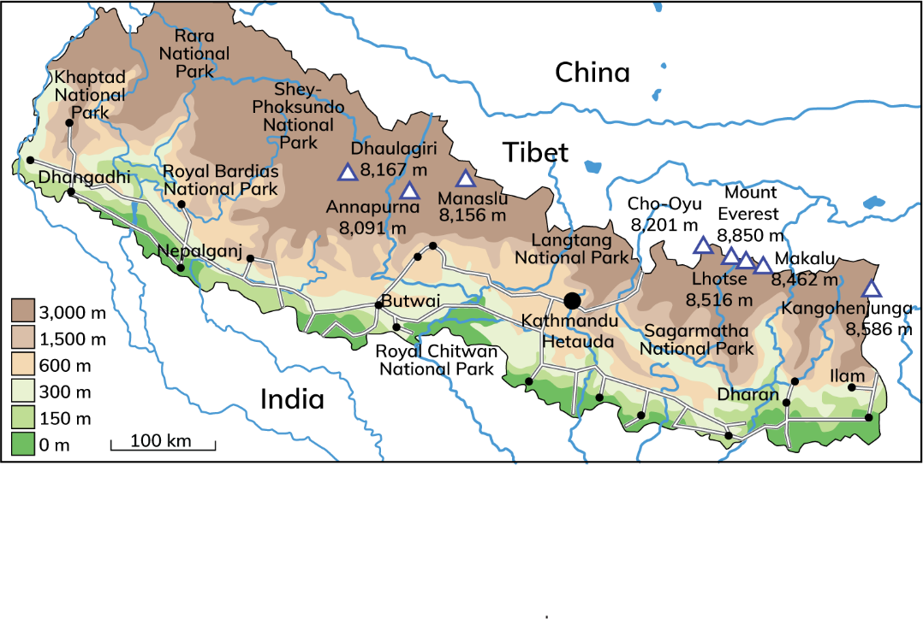
4.3 Describe the economic and social impacts of fold mountains.
The impact of fold mountains on Nepal
Himalayas
Indian Plate and Eurasian Plate
Earthquakes: 25 April 2015 – 7.8 magnitude
Affected 8 million people
8,000 people died, 10,000 injured
130,000 buildings destroyed
Avalanches, landslides

Slide 25
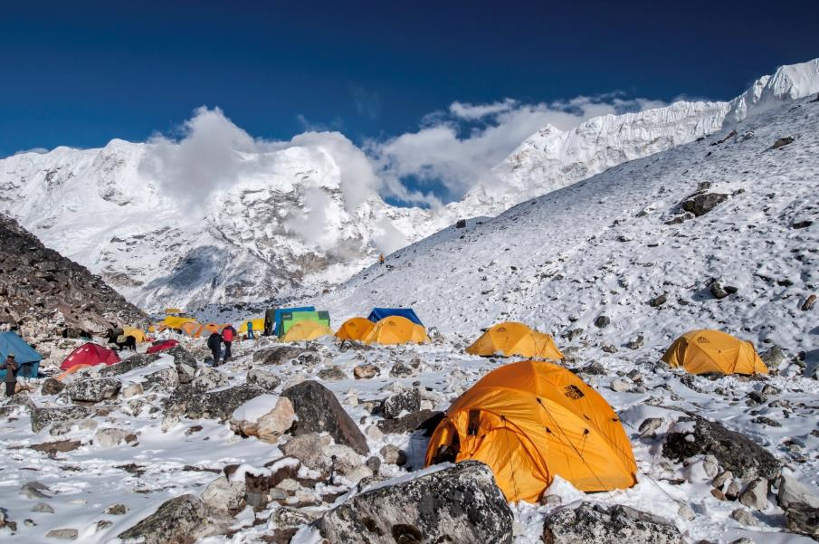
4.3 Describe the economic and social impacts of fold mountains.
The impact of fold mountains on Nepal
Tourism
Major industry – 5 per cent of Nepal’s income
1,500,000 jobs
Mount Everest
500,000 tourists
Climbers to purchase permits
Valuable source of income

Slide 26

4.3 Describe the economic and social impacts of fold mountains.
The impact of fold mountains on Nepal
1. Population of approximately 30 million; highest density in the south
2. Two-thirds depend on agriculture: tobacco, sugar cane, grains, grazing
3. Rural−urban migration: Central Development Region – population 9 million
4. North of the country: too mountainous to support a population

Slide 27

4.3 Describe the economic and social impacts of fold mountains.
1. Why are forests planted in upland areas?
2. Explain two reasons why settlement avoids mountains.
3. Describe one advantage and one disadvantage of mountains to Nepal.
4. Describe briefly one way mountains impact on transport.
5. Identify one way mountains affect the location of settlement.

Slide 28
4.3 Describe the economic and social impacts of fold mountains.
Higher-order questions 2
1. Are there any types of mountains other than fold mountains?
2. What impact will climate change have on how people use mountains?
3. How are volcanoes, earthquakes and fold mountains connected?

Slide 29
4.3 Describe the economic and social impacts of fold mountains.
Go to Section 4.3 on page 15 of your Skills Book.

Slide 30
Assess your progress
Go to page 15 of your Skills Book and assess your progress.
4.1 Explain how fold mountains are formed.
4.2 Describe the distribution of fold mountains.
4.3 Describe the economic and social impacts of fold mountains.
Identify any gaps in your learning. Use the Rapid Revision on page 39 of your Textbook to jog your memory.

